Slide 1



Amazon Web Services
(AWS)
5. ELB & ASG - Elastic Load Balancing & Auto Scaling Groups

Slide 2



What is load balancing
Load balancers are servers that forward internet traffic to multiple servers (EC2 Instances) downstream.
Load balancer

Slide 3
Why use a load balancer?
Spread load across multiple downstream instances
Expose a single point of access (DNS) to your application
Seamlessly handle failures of downstream instances
Do regular health checks to your instances
Provide SSL termination (HTTPS) for your websites
High availability across zones

Slide 4
Why use an Elastic Load Balancer?
An ELB (Elastic Load Balancer) is a managed load balancer
  AWS guarantees that it will be working
  AWS takes care of upgrades, maintenance, high availability
  AWS provides only a few configuration knobs
It costs less to setup your own load balancer but it will be a lot more effort on your end (maintenance, integrations)
3 kinds of load balancers offered by AWS:
  Application Load Balancer (HTTP / HTTPS only) – Layer 7
  Network Load Balancer (ultra-high performance, allows for TCP) – Layer 4
  Classic Load Balancer (slowly retiring) – Layer 4 & 7

Slide 5
What’s an Auto Scaling Group?
In real-life, the load on your websites and application can change
In the cloud, you can create and get rid of servers very quickly
The goal of an Auto Scaling Group (ASG) is to:
  Scale out (add EC2 instances) to match an increased load
  Scale in (remove EC2 instances) to match an decreased load
  Ensure we have a minimum and a maximum number of machines running
  Automatically register new instances to a load balancer
  Replace un healthy instances
Cost Saving: only run at an optimal capacity (principle of the cloud)

Slide 6
Auto Scaling Group in AWS
Maximum Size
Actual Size / Desired Capacity
Minimum Size
Scale Out as Needed
EC2
Instance
EC2
Instance
EC2
Instance
EC2
Instance
EC2
Instance
EC2
Instance
Auto Scaling Group

Slide 7
Auto Scaling Group in AWS
Web Traffic
Load balancer
EC2
Instance
EC2
Instance
EC2
Instance
EC2
Instance
EC2
Instance
EC2
Instance
Auto Scaling Group

Slide 8
Auto Scaling Group – Scaling Strategies
Manual Scaling: update the size of an ASG manually
Dynamic Scaling: Respond to changing demand
  Simple / Step Scaling
    When a CloudWatch alarm is triggered (Example CPU > 70%), then add 2 units
    When a CloudWatch alarm is triggered (Example CPU < 30%), then remove 1
  Target Tracking Scaling
    Example: I want the average ASG CPU to stay at around 40%
  Scheduled Scaling
    Anticipate a scaling based on known usage patterns
    Example: increase the min. capacity to 10 at 5pm on Fridays

Slide 9
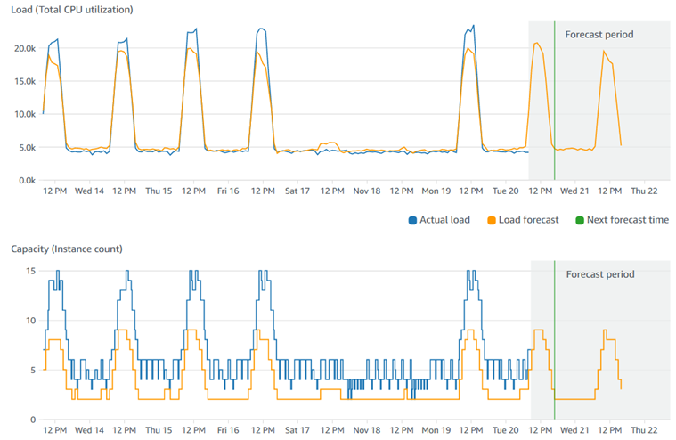
Auto Scaling Group – Scaling Strategies
  Predictive Step Scaling
    Uses Machine Learning to predict future traffic ahead of time
    Automatically provisions the right number of EC2 instances in advanced
  Useful when your load has predictable time-based patterns

